Slide 1




A Carbon Cycle Data Assimilation System
at LSCE using
multiple data streams
(CARBONES / GEOCARBON EU-project )
Philippe Peylin, Natasha MacBean, Cédric Bacour, Sébastien Leonard, Vladislav Bastrikov, Fabienne Maignan, Sylvain Kuppel, Diego Santaren, Frédéric Chevallier, Patricia Cadule, Philippe Ciais, Jonathan Barichivich, Catherine Ottle
Laboratoire des Sciences du Climat et de l’Environnement, Paris, France.
& CARBONES / GEOCARBON projects
& DATA providers

Slide 2
The LSCE - CCDAS
The need for Carbon Cycle Data Assimilation Systems

Slide 3

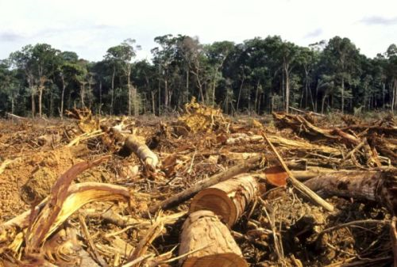
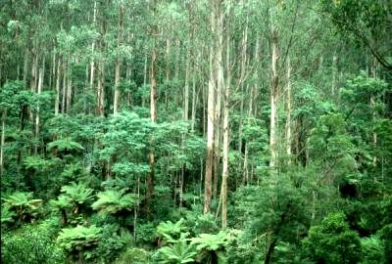


Fate of Anthropogenic CO₂ Emissions (2000-2008)
1.4 PgC y⁻¹
4.1 PgC y⁻¹
45%
+
3.0 PgC y⁻¹
29%
7.7 PgC y⁻¹
26%
2.3 PgC y⁻¹
Le Quéré et al. 2009, Nature-geoscience; Canadell et al. 2007, PNAS, updated
Notes:
Residual is included in the land sink

Slide 4
Atmospheric inversions: IAV
Comparison
of 11 inversions
(RECCAP)
Land
Ocean
JENA_s96
LSCE_var
LSCE_an
CTrac_US
CTrac_EU
C13CCAM
C13MATCH
TRCOM
RIGC
JMA
NCAM
Peylin et al. 2013 BG

Slide 5
Atmospheric inversions: IAV
Comparison
of 11 inversions
(RECCAP)
Strengths:
Include all processes
Acurate at large scale
Land inter-annual variability appears robust
Weaknesses:
No insight on the processes
Poor regional constraint
Land / ocean partition is not robust
No prediction capabilities
Land
Ocean
JENA_s96
LSCE_var
LSCE_an
CTrac_US
CTrac_EU
C13CCAM
C13MATCH
TRCOM
RIGC
JMA
NCAM
Peylin et al.2013 BG

Slide 6
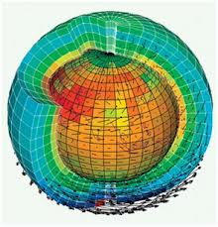



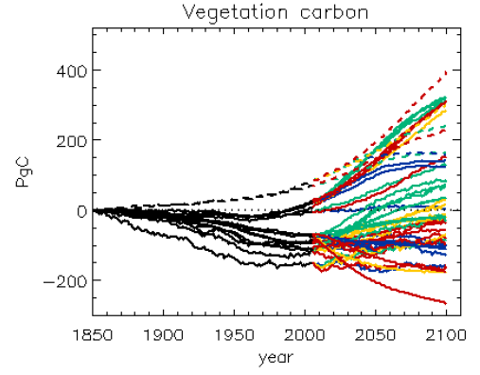
Role of land surface models
IPSL
Land surface models and dynamic global vegetation models are used to:
Monitor long-term trends in carbon, water, energy, vegetation
Attribute the causes of trends and variability
Predict changes into the future under new climate and greenhouse gas regimes
LPJ
Change in global biomass
historical
future
<-uncertainty->
Jones 2013

Slide 7
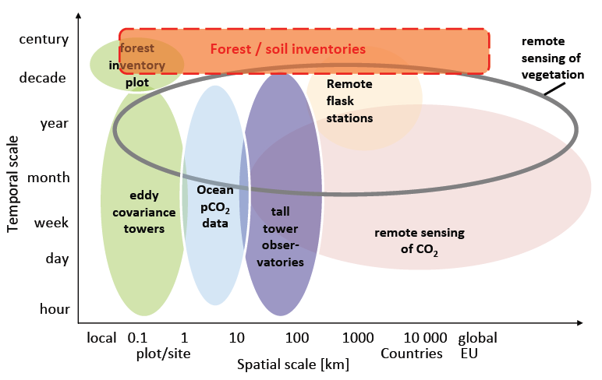
Needs for C-Cycle Data Assimilation System
Large uncertainty from land to
predict global C-balance (C4MIP)
Atm.
data
Data streams
C flux to atmosphere (GtC/yr)
Data
Assimilation
Improve:
Process understanding
Uncertainty estimates
Future climate predictions
Optimized
ecosystem models
➔ reduce the spread ?
Notes:
How to tackle – atm inv., inventories…
Atmospheric inversion problems: Strengths: Include all processes, Can be verified (independent groups), Accurate at global scale
Weaknesses: No insight on the processes, Poor regional constraint, No predictive capability, Prior error structure difficult to establish
Bottom up approach, obs, INVENTORY (read RECCAP)
Look at what we have: observations. Only they provide the door to the real world. They should provide the backbone of the research.
To paraphrase the Philosopher Imanuel Kant, “models without data are empty, and data without models are blind.”
Eddy + forest
Remote sensing of veg
Remote stat + tall
Remote sensing CO2 (dünn, label ausserhalb)
20 – 30 years Carbon cycle reanalysis using
all data constraints : short and long time scales.
Estimate LAND & OCEAN CO2 fluxes
Estimate LAND carbon stocks variations
Estimate Associated Errors
Provide an optimized land ecosystem model
To EVALUATE C-Climate Model
To FORECAST future C cycle
To ATTRIBUTE current C balance

Slide 8
The LSCE - CCDAS
Description of the ORCHIDEE LAND SURFACE MODEL

Slide 9

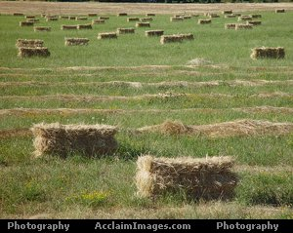


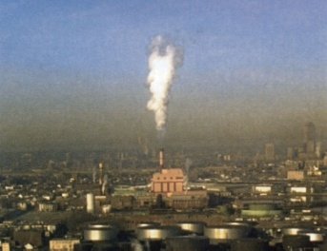

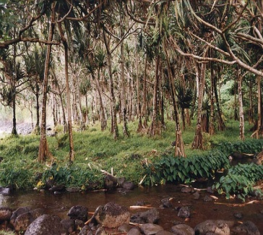
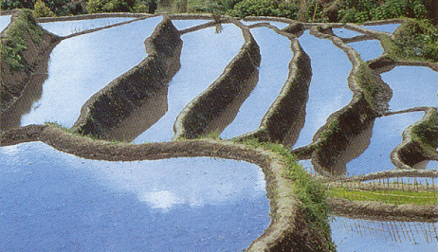
Dynamic Global Vegetation Model ORCHIDEE
Simulates the Energy, Water and Carbon balance
Land component of the IPSL Earth System Model

Slide 10
Main processes
Temperature
Air Humidity
Precipitation
Radiation
CO₂ Concentration
Wind Speed
Solar and
infra-red
Evapotranspiration
Air Turbulence
Net Photosynthesis
Interception by the canopy
CO₂ Flux
Convection of dry heat
Growth & Maintenance
Respiration
Allocation of the assimilates
Surface runoff
litter
Surface
Temperature
Infiltration, storage, drainage
Carbon Budget & nutriments

Slide 11
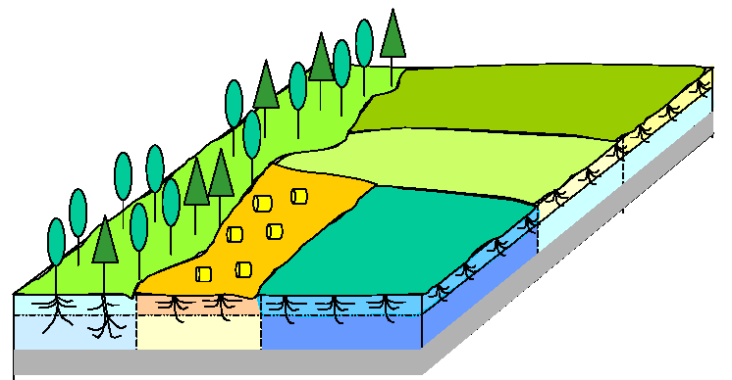
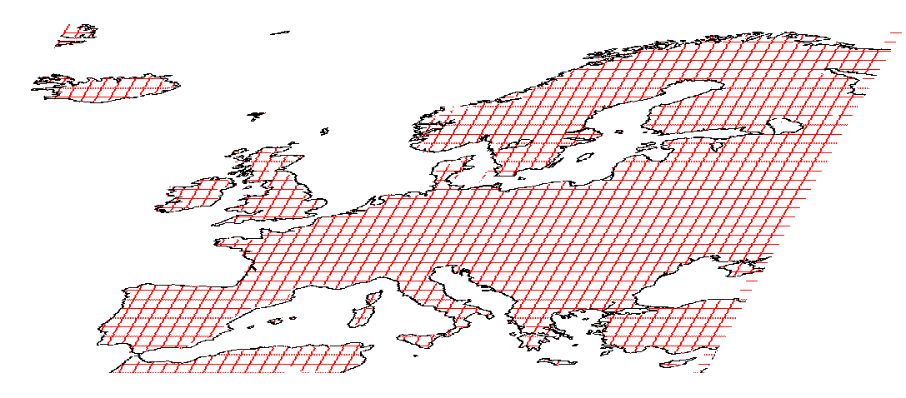
Surface description : a tile approach
A mosaïc of
vegetation
Land cover map
13 different Plant functional types

Slide 12
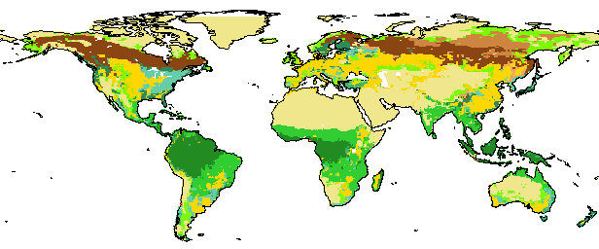
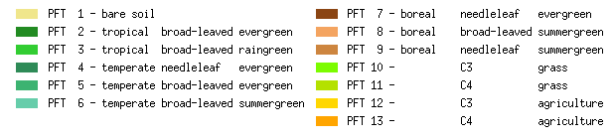
Example of dominant PFT map

Slide 13
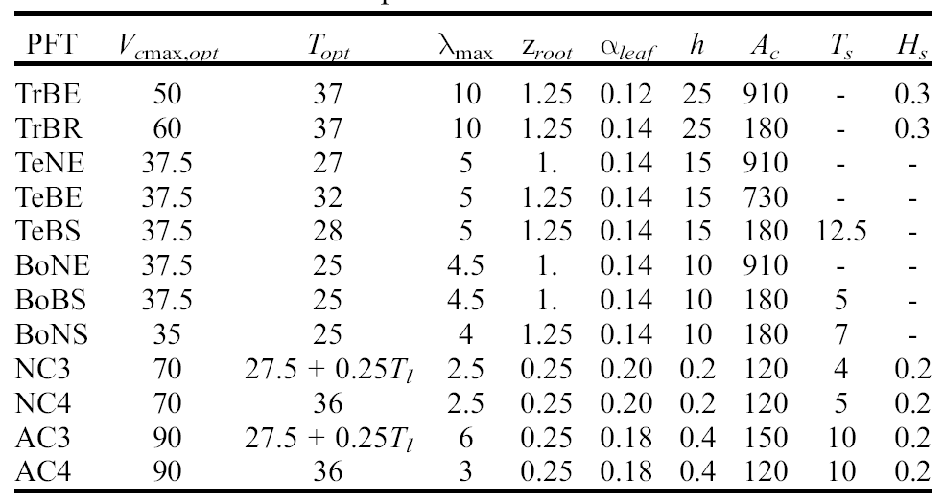
Plant Functional Types
The same set of equations governs C/W/E dynamics
But parameter values differ among PFTs

Slide 14
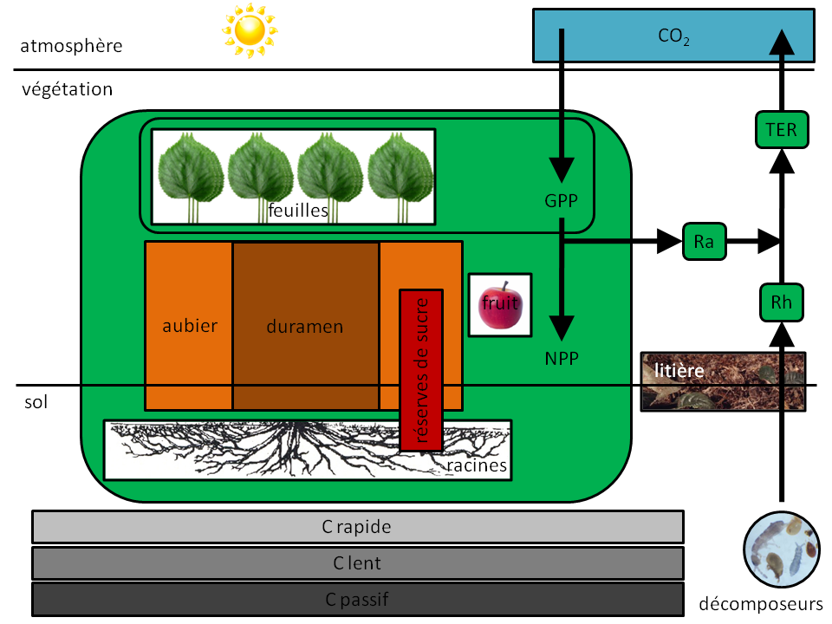
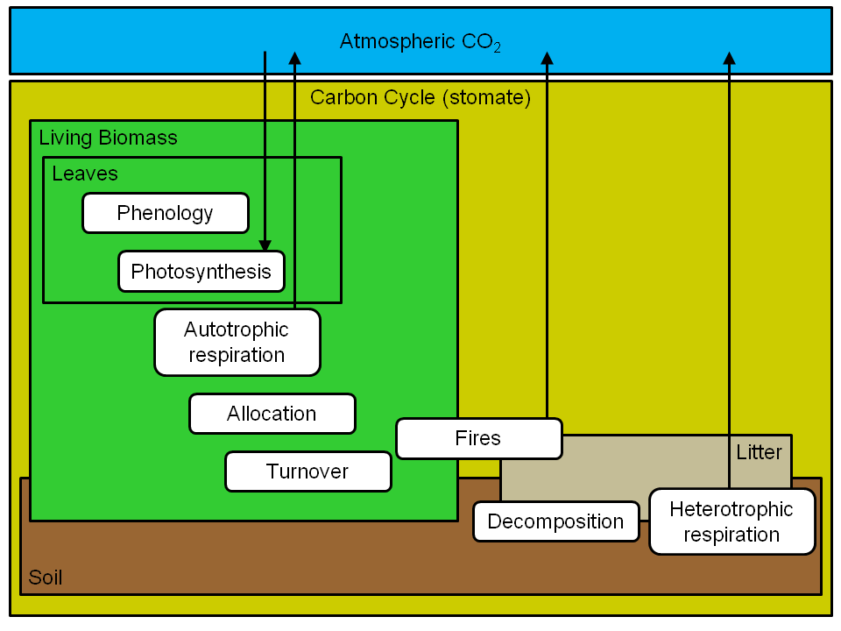
“Slow biogeochemical” Processes

Slide 15
“Slow biogeochemical” Processes
  Phenology - Budburst based on GDD, soil water...
  Senescence: Based on Leaf age, Temp...
  Carbon Allocation:
    8 pools of living biomass
    4 litter pools and 3 soil carbon pools (CENTURY)
  Autotrophic respiration: Maintenance & Growth
  Heterotrophic Respiration
  Fire module (SPITFIRE)
  Turnover : death of plants, etc.

Slide 16
Biomass allocation

Slide 17
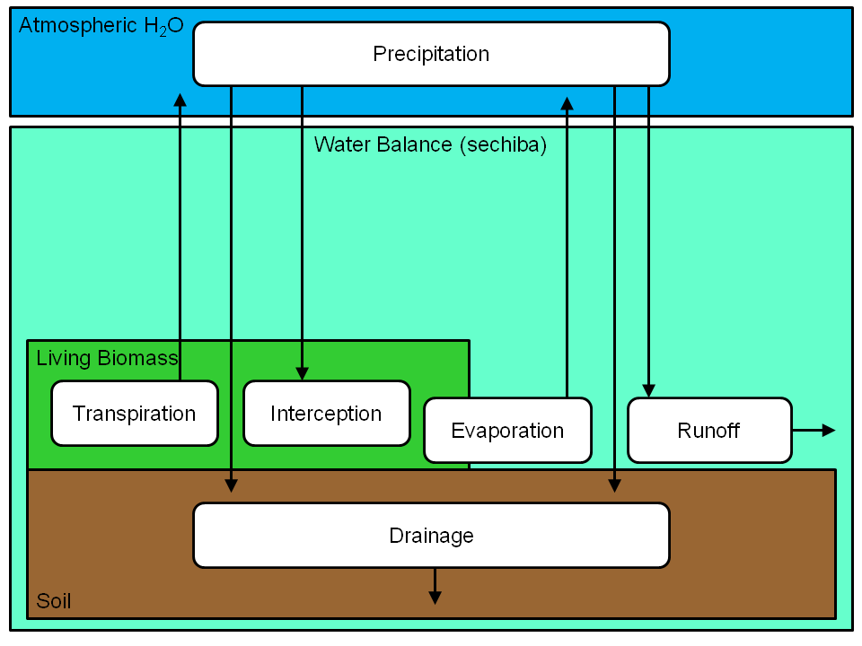
Hydrological Processes in ORCHIDEE

Slide 18
Hydrological Processes in ORCHIDEE
Partition of throughfall between infiltration and runoff
Water fluxes in soils (soil moisture and drainage)
Routing of runoff into river discharge
Human pressures, e.g. irrigation
Interactions with floodplains (fluxes and storage)
Wetlands
Snow pack processes
Permafrost (freeze/thaw in the soil)
Interactions with groundwater tables (fluxes and storage)
Notes:
18

Slide 19
Driving data
Meteorological forcing (temp., precip., air humidity, surface pressure, wind speed, short- and longwave radiation)
Atmospheric CO2
Vegetation type (PFT) (when not using DGVM)
Soil Type
Land Cover Change
Notes:
19

Slide 20
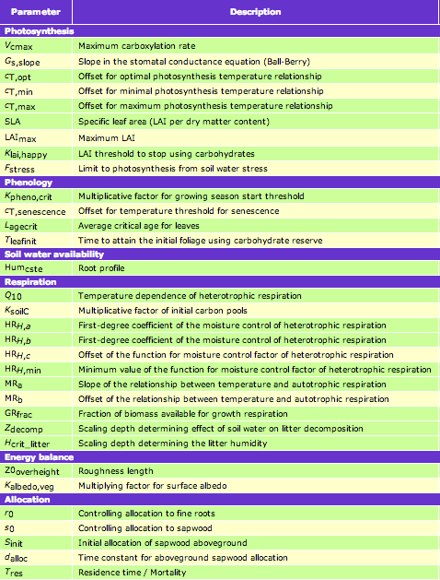
Parameters
Notes:
20

Slide 21


ORCHIDEE model: current status
Forest management
module
Nitrogen
cycle
Fires
Crops
Managed grass
Temperate
Crops
Assimilation
Of variables
Bare soil / desert
Tropical
crops
Forest
Natural grass
Modules
implementation
PASIM
Multi-layer soil hydrology’
grassland
Generalization of PFT concept (number not limited)
A 11-layer hydrological scheme
Scientific documentation

Slide 22
The LSCE - CCDAS
Description of the
LSCE - CCDAS

Slide 23
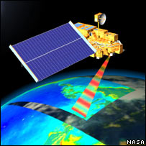
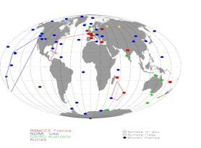
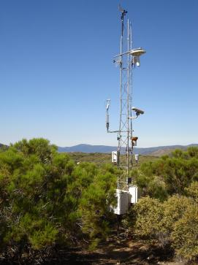
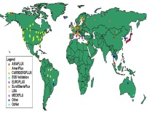
Structure of the LSCE CCDAS
Forcing data
Assimilation data
Validation data
Fossil Fuel & Biomass Burning fluxes
Meteo. data
IGBP LC
Satellite
data
CCDAS
Carbon Cycle Data
Assimilation System
Atmos.
Conc.
Ocean flux
Model OCVR
CO₂ vertical
Profiles
Forest & Soil
C stock
Satellite data
LAND
ORCHIDEE
Atmosph
LMDZ
Flux
Tower
Ocean pCO2
data
Optimized model parameters
➔ Carbon fluxes & pools
(values & uncertainties)
Notes:
Fossil fuel from EDGAR database, UNFCCC National Inventory Reports, the GAINS database, and the VULCAN project for the US are used
Global maps of biomass burning emissions are taken from the GVFEDv2.0 dataset based upon ATSR and MODIS fire counts and burned area information (Van der Werf et al., 2006)

Slide 24
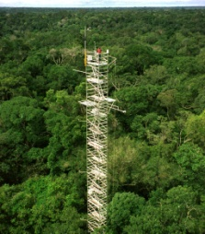

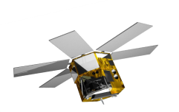
Structure of the LSCE CCDAS
PFT composition
ecosystem parameters
initial conditions
climate
NEE, LE, (H)
flux tower
measurements
Y^{flux}
J(X)‏
J(X)‏
J(X)‏
parameters
(X)‏
M(X)‏
≠
biomass data
ORCHIDEE
Y^{fAPAR}
satellite
fAPAR
Optimizer BFGS
J(X) and dJ(X)/X
Atm CO₂
Cost function:
Iterative minimization using either:
- Variational approach (with Tangent Linear model for DJ/dx)
- Monte Carlo approach
Notes:
Fossil fuel from EDGAR database, UNFCCC National Inventory Reports, the GAINS database, and the VULCAN project for the US are used
Global maps of biomass burning emissions are taken from the GVFEDv2.0 dataset based upon ATSR and MODIS fire counts and burned area information (Van der Werf et al., 2006)

